Slide 1
Beat the Machine
Reverse Engineering Basics in Puzzle Form

Slide 2
So what is Reverse Engineering?
Definition of reverse engineering
: the activity of studying the parts of something to see how it was made and how it works so something like it can be made

Slide 3

How do I do it?
Forward Development Process
Do the forward engineering process…in reverse.
#include <stdio.h>
int main()
{
unsigned char x,y;
printf(“Lightbulb!”);
}
01 E2 45 68 28 14 58 92 B3 3A 70CE 10 00 54 5F D3 91 18 17
MOV R1, R2
CMP R1, 0x64
JNZ loop
CALL printf
Concept/
Design
Human-readable
Code
Assembly
Code
Machine Code
(in Hexadecimal)
Physical
Bits

Slide 4
Why should you care?
Reverse Engineering is used for:
Characterizing a system,
Discovering vulnerabilities,
Understanding how to use undocumented or hidden features, and
Changing how a system behaves

Slide 5
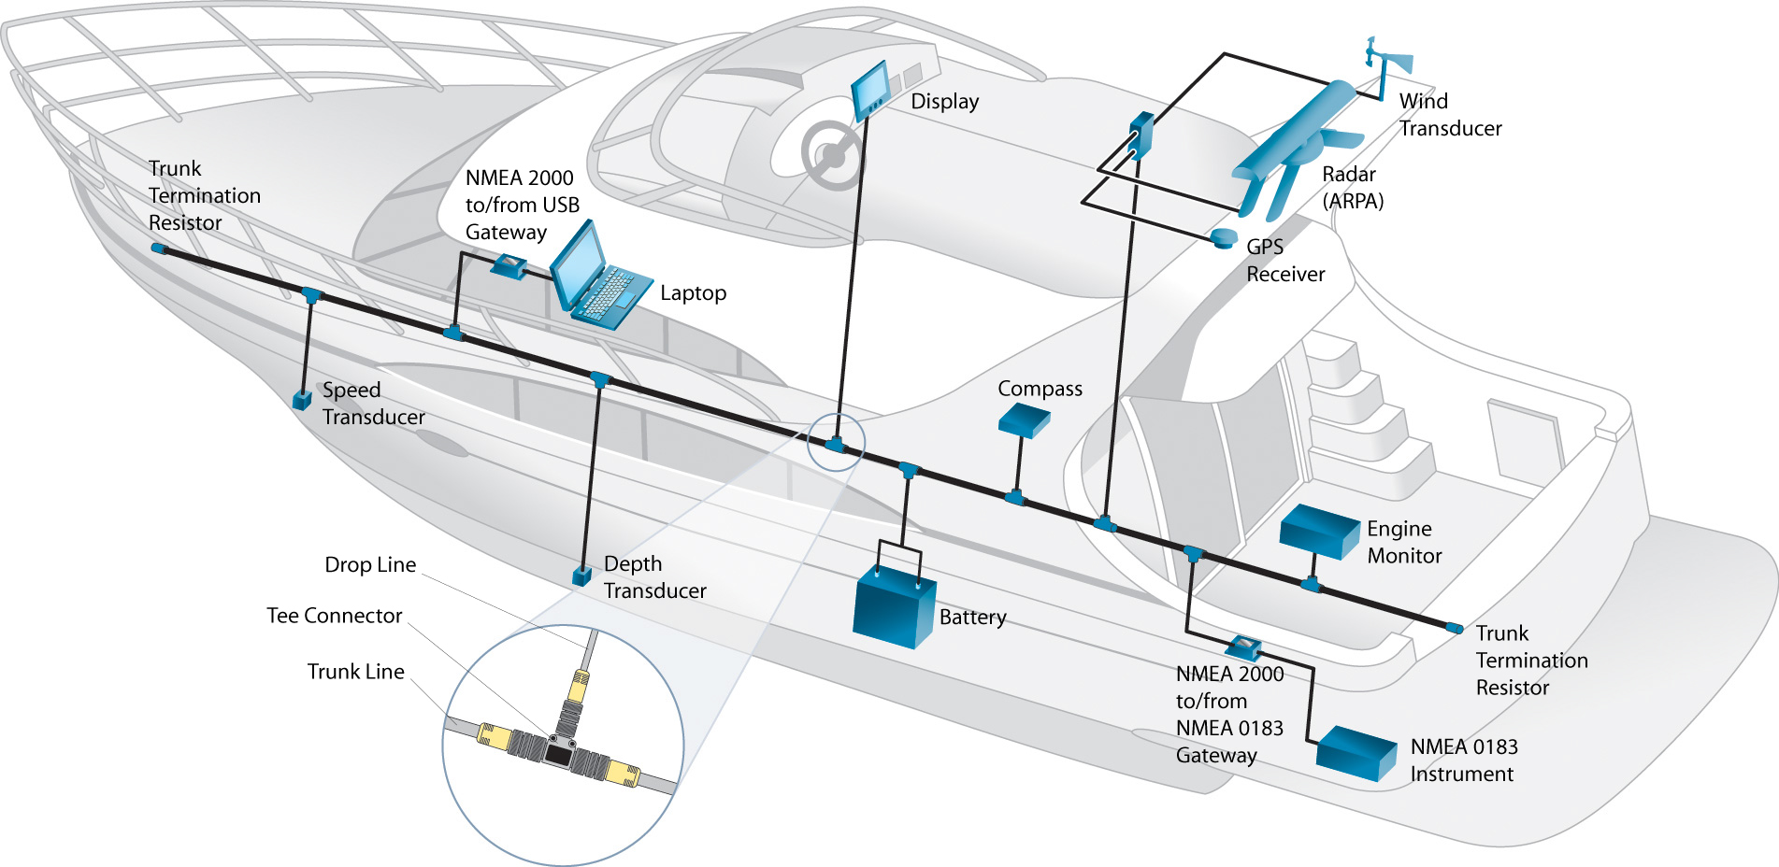
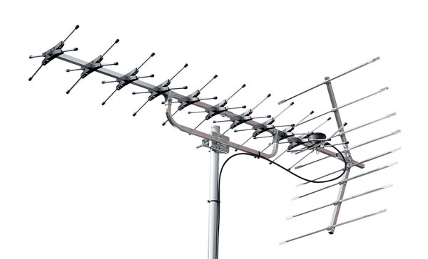
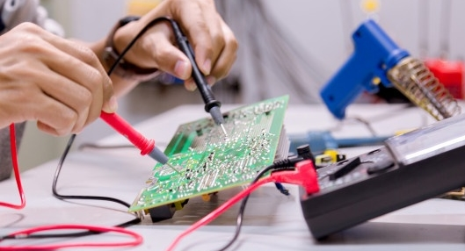
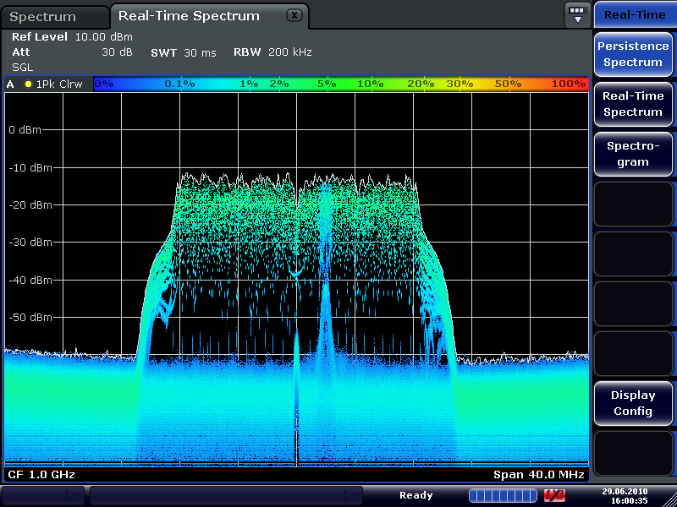
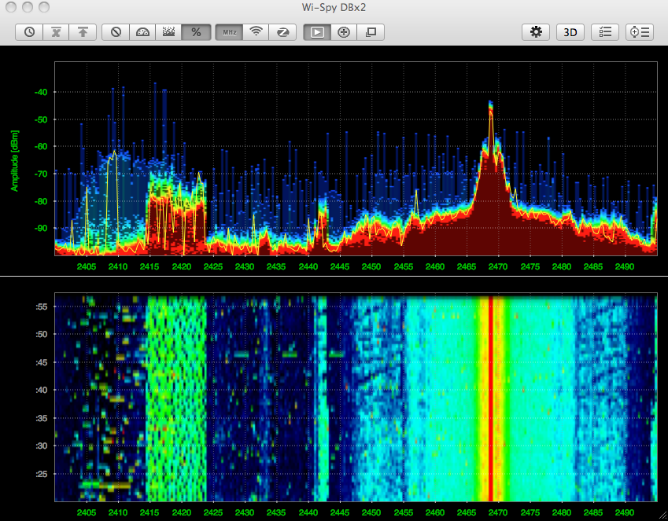
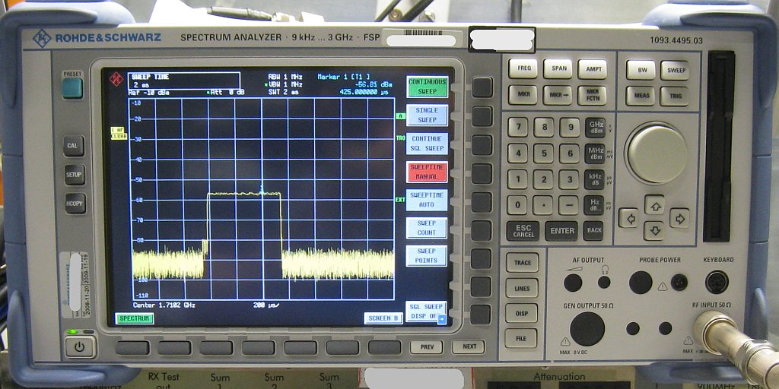
Types of Reverse Engineering
System-Level Reverse Engineering
Protocol Reverse Engineering
Hardware Reverse Engineering
Software/ Firmware/ Binary Reverse Engineering

Slide 6
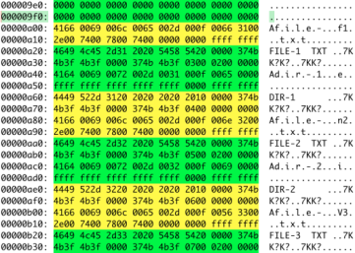
Software/ Firmware/ Binary Reverse Engineering
Access to executable files (binary) or firmware image
Use disassembler to obtain machine code/ assembly instructions
Use decompiler to obtain higher-level representation of code
Analyze to accomplish your goal
Analysis
Dynamic (Debugging)
Static (Looking at instructions)

Slide 7
Architecture?
The CPU’s machine code & how it processes that code
Examples:
x86 – Most laptops and user computers (Windows and Mac)
ARM – Smartphones and tablets, probably most common embedded processor
MIPS – Routers (and Computer Architecture classes!)
PowerPC – pre-2005 Macs,
Microprocessors: 8051, MSP430, SuperH, PIC, AVR, etc.

Slide 8
Binary & Hex Review
Decimal | Binary | Hexadecimal
0 | 0000 0000 | 0x00
1 | 0000 0001 | 0x01
2 | 0000 0010 | 0x02
3 | 0000 0011 | 0x03
4 | 0000 0100 | 0x04
5 | 0000 0101 | 0x05
6 | 0000 0110 | 0x06
7 | 0000 0111 | 0x07
8 | 0000 1000 | 0x08
9 | 0000 1001 | 0x09
10 | 0000 1010 | 0x0A
11 | 0000 1011 | 0x0B
12 | 0000 1100 | 0x0C
13 | 0000 1101 | 0x0D
14 | 0000 1110 | 0x0E
15 | 0000 1111 | 0x0F
16 | 0001 0000 | 0x10
17 | 0001 0001 | 0x11
Bit: 1 or 0
Byte: 8 bits
Max Value: 11111111 → 0xFF → 255
Binary: number represented by one’s and zero’s (base 2)
Hexadecimal: number represented in base 16 (0-F)

Slide 9
MOSIS – Example Architecture
Simple 16-bit architecture we designed for these exercises
Registers: R0-R15
Instruction sets lists all of the available instructions, a description, and how they are encoded into hex/binary.
MOV – copy the contents of one register to another
Opcode (4 bits) | Unused (4 bits) | Destination Register (4 bits) | Source Register (4 bits)
0 0 0 0 | 0 0 0 0 | Y Y Y Y | X X X X
Set register Y equal to register X.
Examples:
0000 0000 0001 0010 → 0x0012 MOV R1, R2 Set R1 equal to R2.
0000 0000 0010 0001 → 0x0021 MOV R2, R1 Set R2 equal to R1.

Slide 10
Exercise #1 – Source Code to Assembly (MOSIS)
i = R0
j = R2
0x00: movi R0, 0 Set i = 0
0x02: movi R1, 3
0x04: cmp R0, R1
0x06: jgte 0x1A Jump if R0 >= R1
0x08: movi R2, 0xA Set j = 10
0x0A: movi R3, 0
0x0C: cmp R2, R3
0x0E: jlte 0x18 Jump if R2 <= R3
0x10: movi R4, 1
0x12: add R0, R0, R4 Set i = i + 1
0x14: sub R2, R2, R4 Set j = j - 1
0x16: jmp 0xC
0x18: add R0, R0, R0 Set i = i + i
0x1A: out R0 Print i
i = 0
if (i < 3) {
j = 10
while (j > 0) {
i = i + 1
j = j – 1
}
i = i + i
}
print i

Slide 11
The life of code
int i = 0;
if (i < 3) {
int j = 10;
while (j > 0) {
i = i + 1;
j = j – 1;
}
i = i + i;
}
print i;
001010001010111011010110101101100010000100011011011011000001011110111101101011011011011101110101
COMPILER
DISASSEMBLER
HEX EDITOR
movi R0, 0
movi R1, 3
cmp R0, R1
jgte 0x1A
movi R2, 0xA
movi R3, 0
cmp R2, R3
jlte 0x18
movi R4, 1
add R0, R0, R4
DECOMPILER
28AED6B6211B6A1000F034B512A145B8D123C922

Slide 12
Exercise #2 – assembly to Source code
Address | Disassembly | Comments
000 | MOVI R1, 1 | R1 = 1
002 | MOVI R2, 1 | R2 = 1
004 | ADD R3, R1, R2
006 | OUT R3
008 | MOV R1, R2
00A | MOV R2, R3
00C | JMP 004

Slide 13
Exercise #2 – assembly to C (Pseudocode)
R1 = i, R2 = j, R3 = k
int i = 1;
int j = 1;
while (1) {
int k = i + j;
print k;
i = j;
j = k;
}
0x00: MOVI R1, 1
0x02: MOVI R2, 1
0x04: ADD R3, R1, R2
0x06: OUT R3
0x08: MOV R1, R2
0x0A: MOV R2, R3
0x0C: JMP 0x04

Slide 14
Exercise #3 – Identify the bug
You have a program that accepts the hour on the 24-hour clock as an ASCII string input and outputs an ASCII string of the hour on the 12-hour clock.
Examples:
Suggested Process:
Choose an input value
Run through code and note the value of each register at each instruction
Write pseudocode
Identify vulnerability
Write patches which mitigate vulnerability
INPUT | OUTPUT | First Instructions
“23” | “11” | R1 = 0x32, R2 = 0x33
“09” | “09” | R1 = 0x30, R2 = 0x39
“14” | “02” | R1 = 0x31, R2 = 0x34

Slide 15
Exercise #4 – Crack the Code

Slide 16
What now?
Classes
Computer Architecture
Nand 2 Tetris: http://www.nand2tetris.org/about.php and Coursera class
Operating Systems
Circuits
Forward Engineering Process
Learn C and practice, practice, practice!
C development → Assembly → C program
Free Online Training Resources
http://www.opensecuritytraining.info/Training.html
http://hackaday.com/
Others
Zachtronics games (TIS-100, Shenzhen I/O, Ruckingenur)
PoC||GTFO

Slide 17
Tools
Disassemblers
Ghidra Disassembler & Decompiler (https://ghidra-sre.org/)
IDA Disassembler
Objdump
Radare2
Debuggers
OllyDbg
WinDbg
GDB

